Slide 1


Slide 2
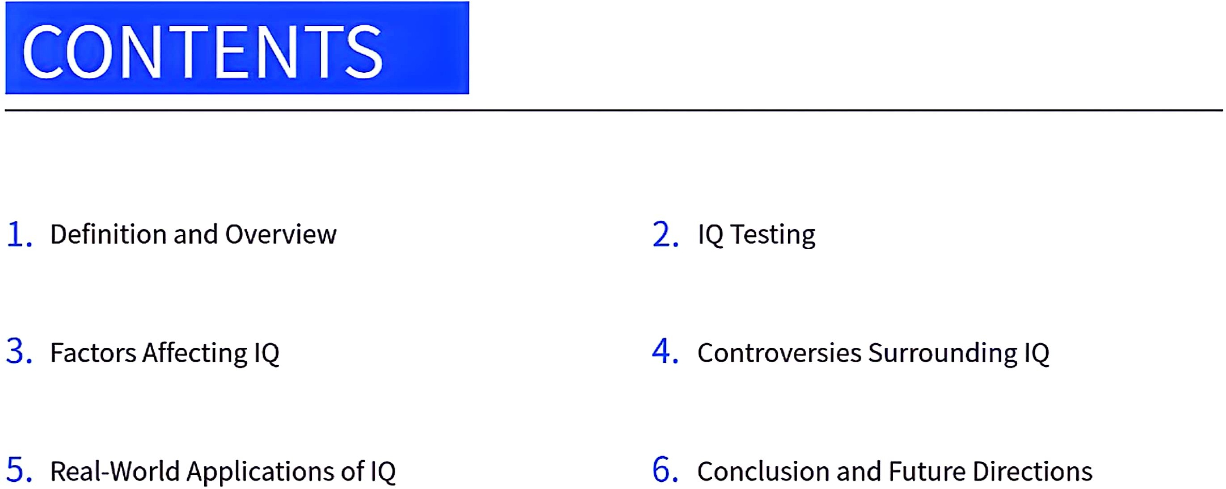

CamScanner

Slide 3



CamScanner

Slide 4
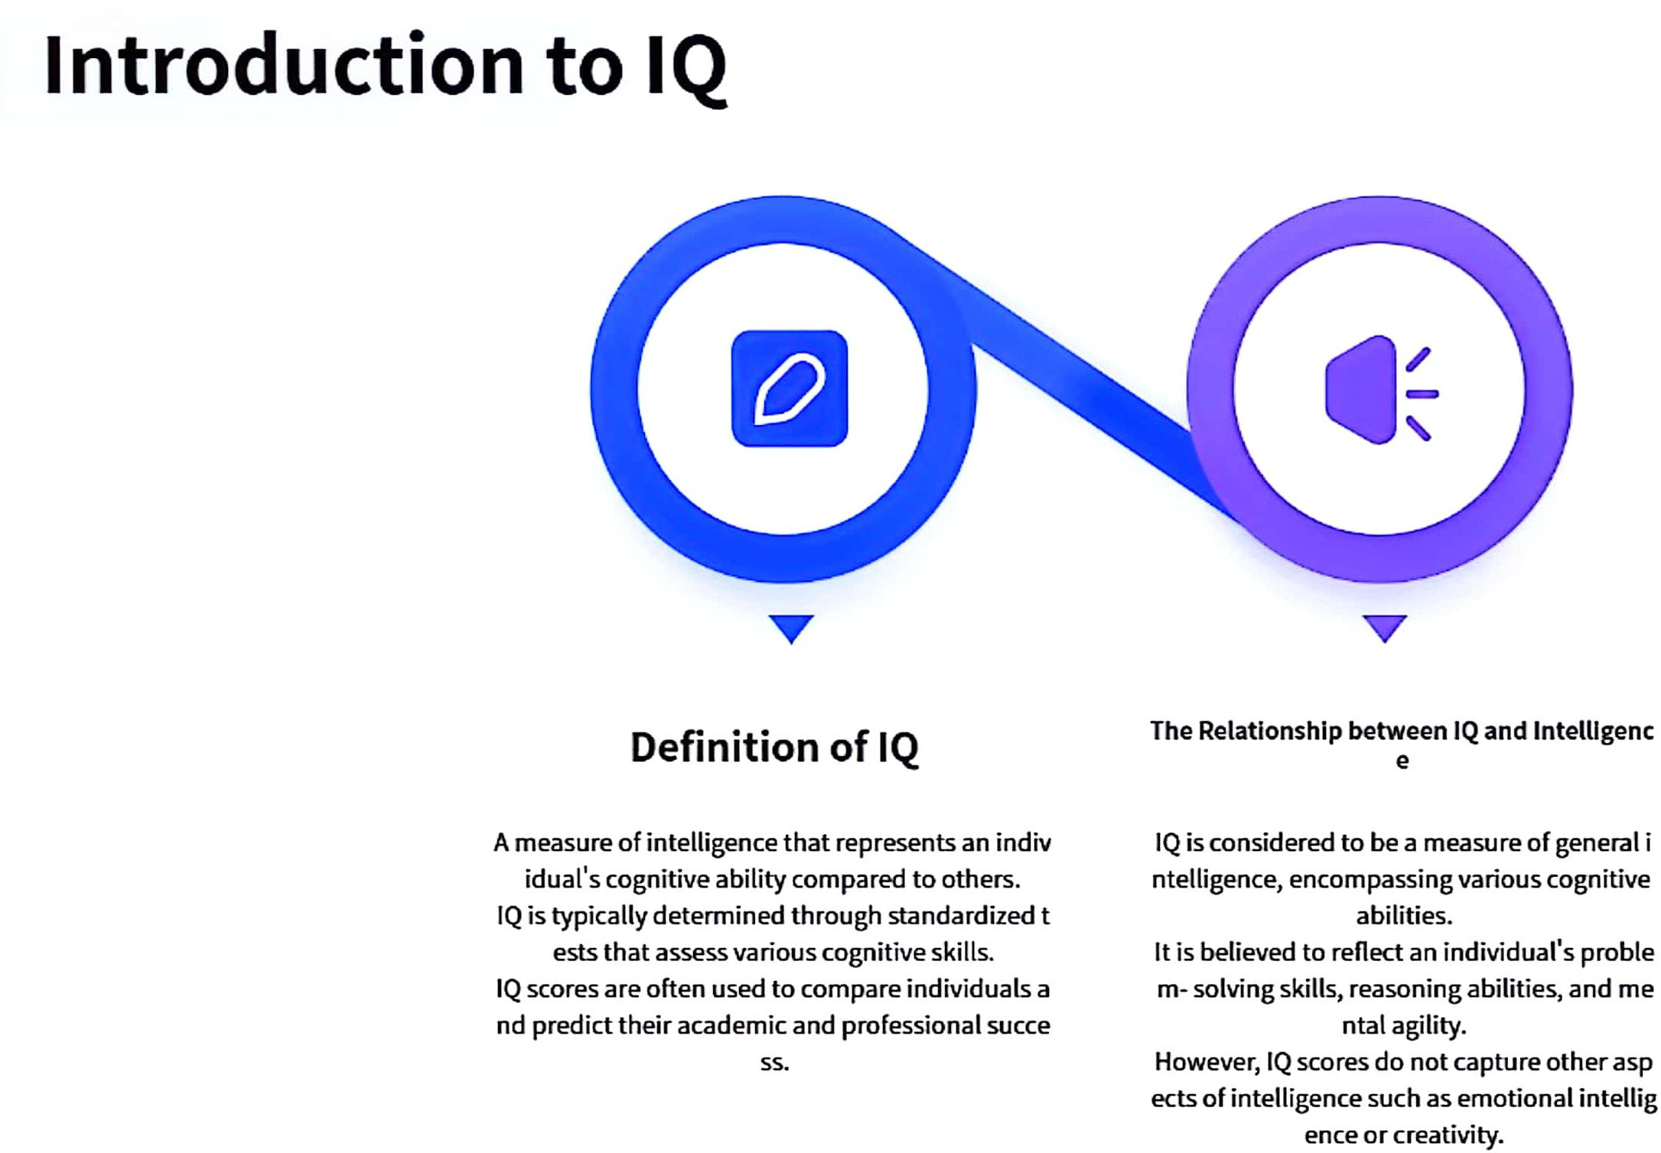

CamScanner

Slide 5
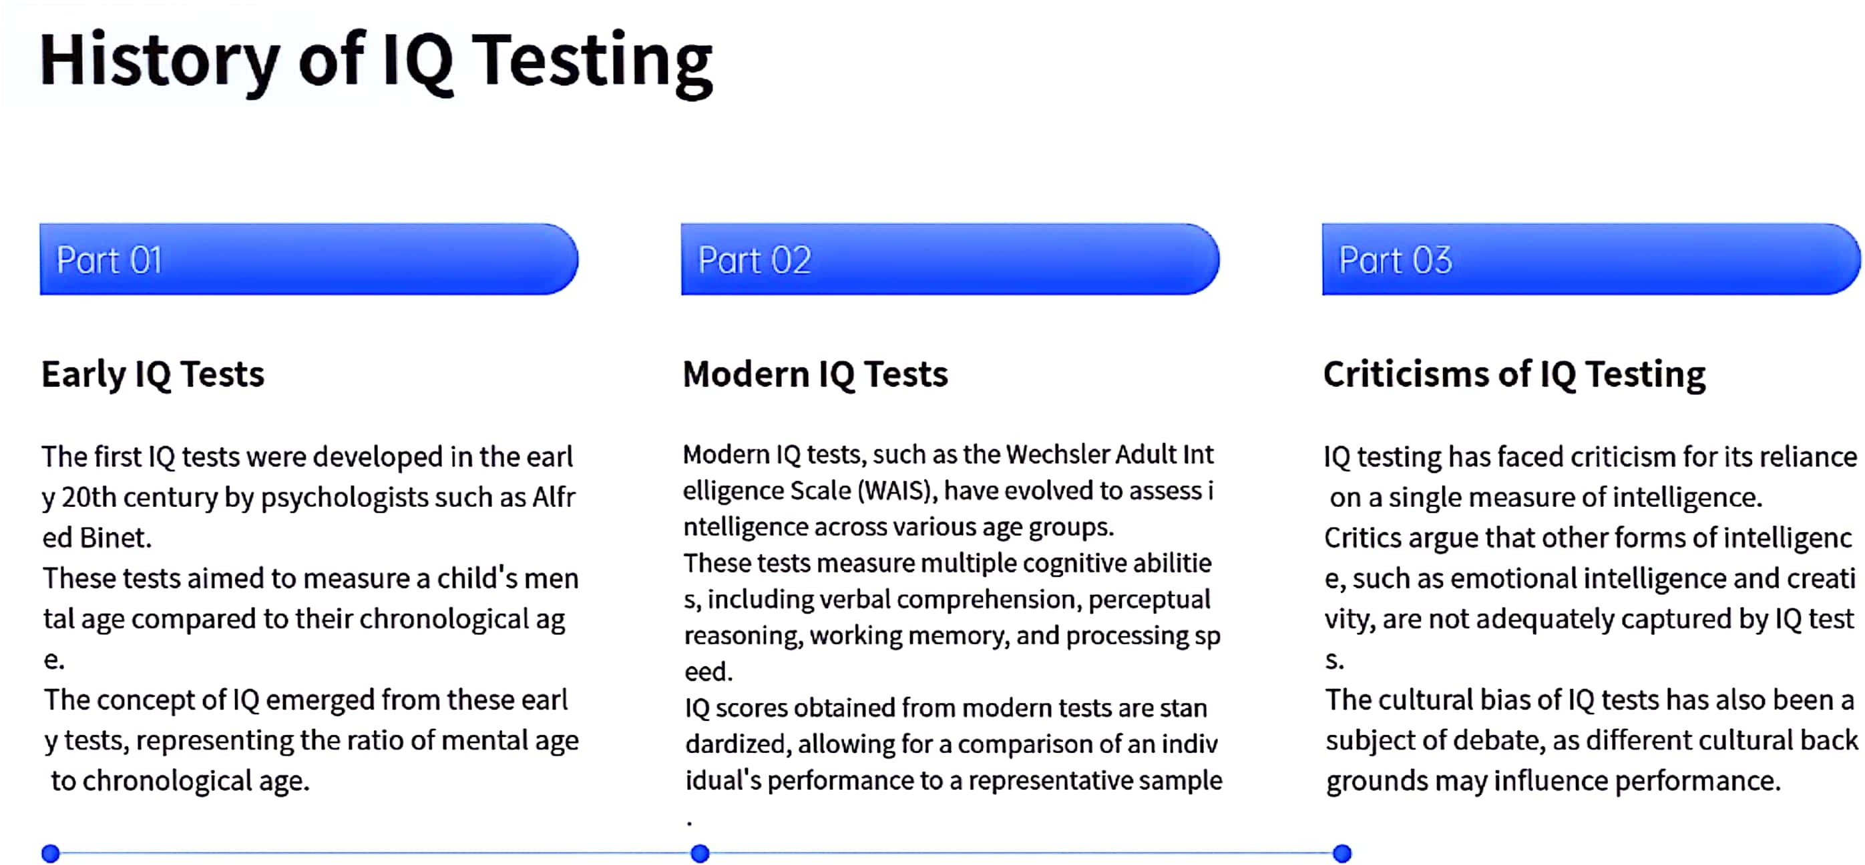

CamScanner

Slide 6



CamScanner

Slide 7
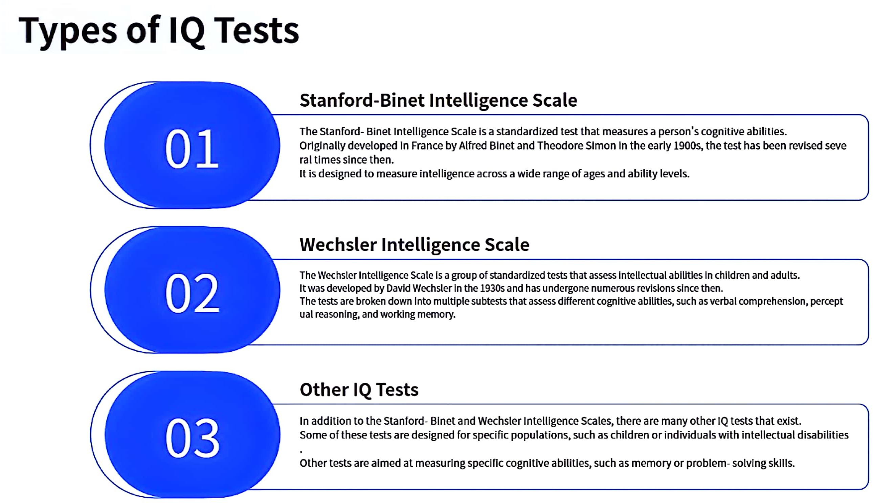

CamScanner

Slide 8
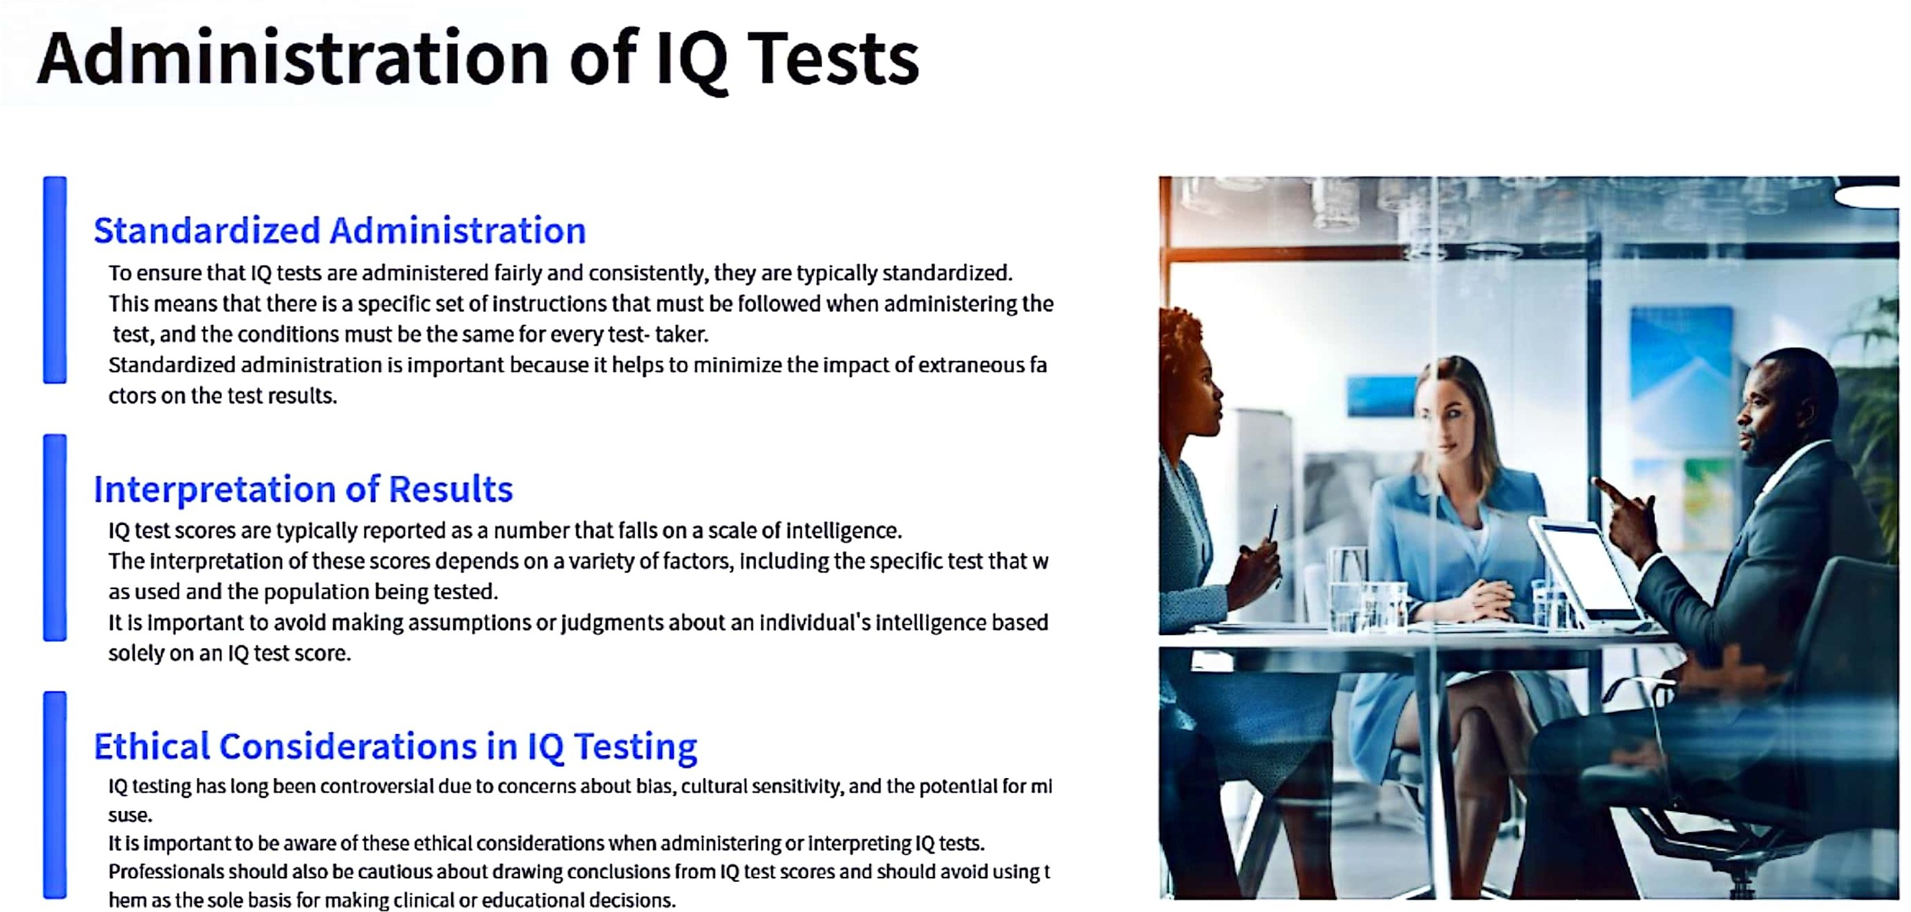

CamScanner

Slide 9



CamScanner

Slide 10


CamScanner

Slide 11
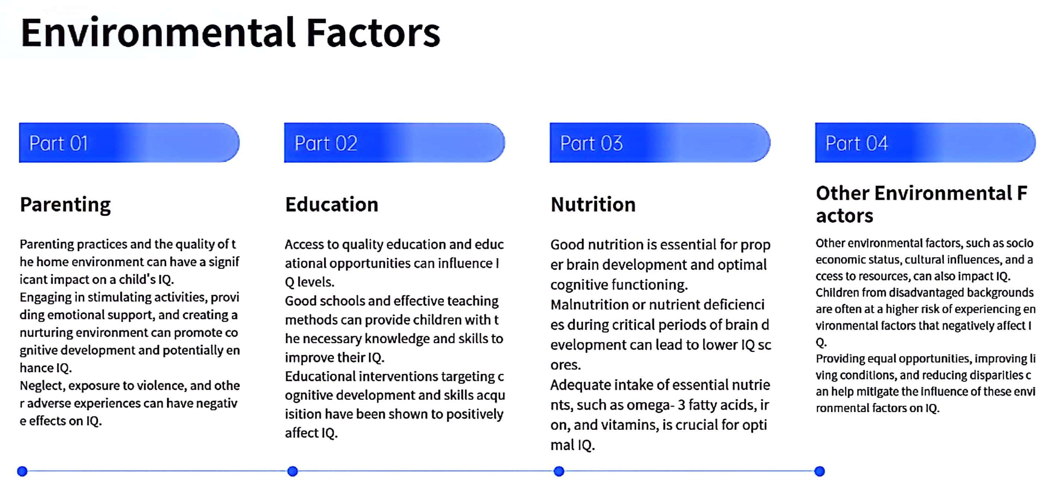


CamScanner

Slide 12


CamScanner

Slide 13


CamScanner

Slide 14
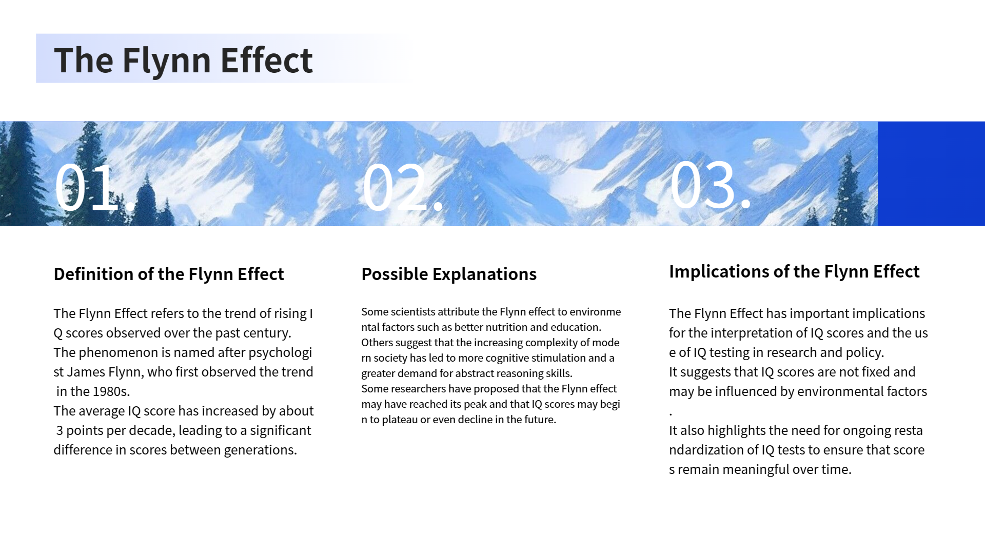

CamScanner

Slide 15


CamScanner

Slide 16
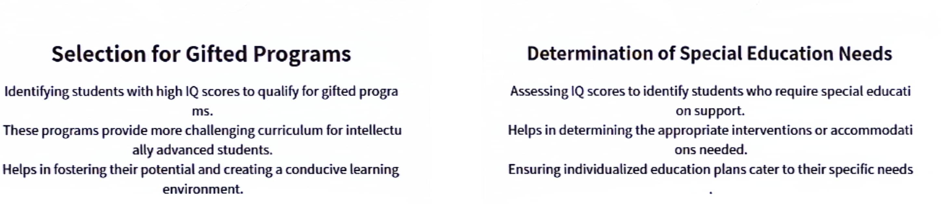

CamScanner

Slide 17
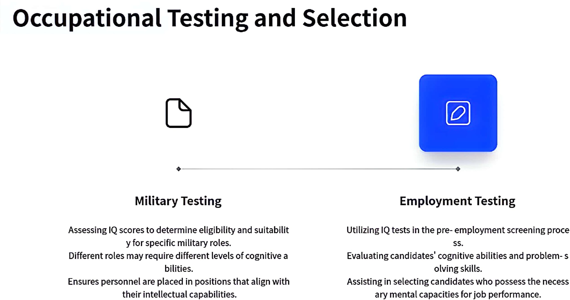

CamScanner

Slide 18
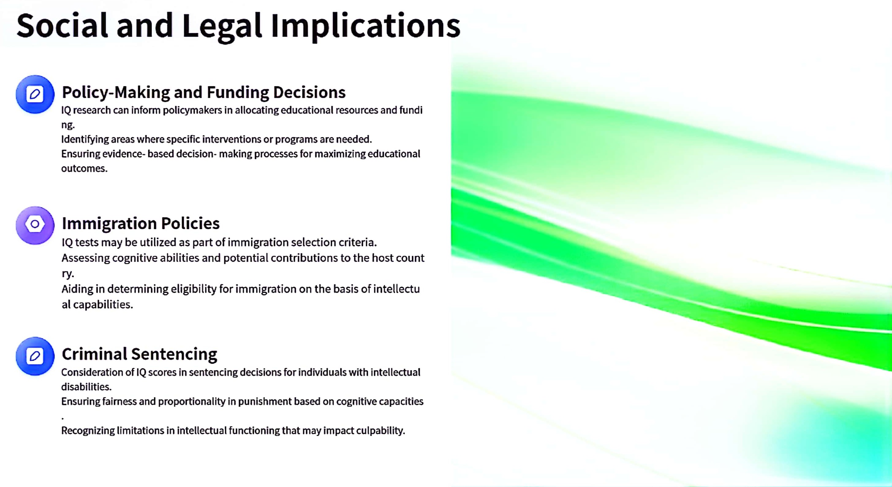

CamScanner

Slide 19


CamScanner

Slide 20
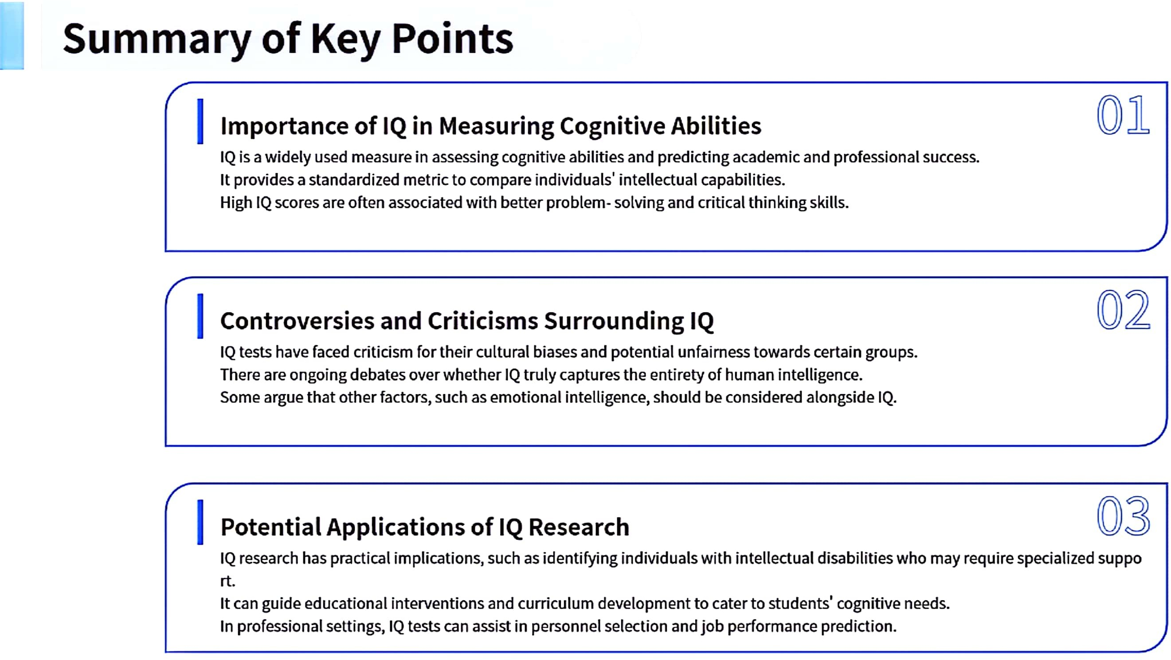

CamScanner

Slide 21
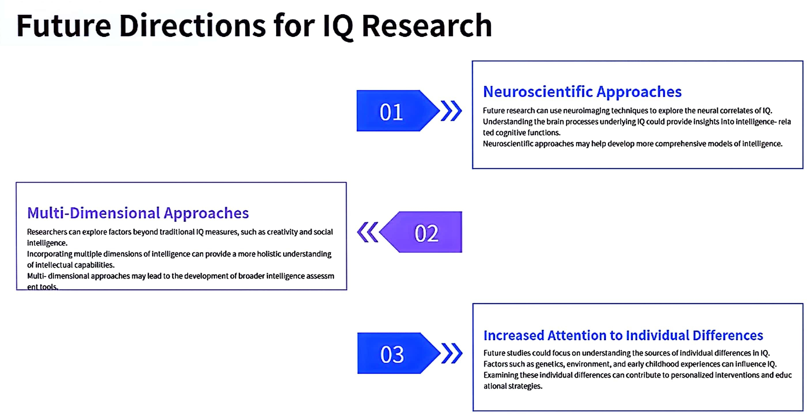


CamScanner

Slide 22


CamScanner

